Slide 1

EDA NSL-KDD Dataset
Group 2
Zahra Joulaei, Will Daly, Wei Dong
1

Slide 2
Problem Statement
Exploratory Data Analysis
Dataset & Task Formulation
Class Distribution & Imbalance
EDA
NSL-KDD Dataset
Data Overview
Implementation & Code Overview
Dataset Structure & Feature Characteristics
Data Loading & Statistical Inspection
Data Preprocessing
Findings & Modeling Direction
Cleaning Strategy & Zero-Inflated Features
Key Insights & Next Steps
2

Slide 3
Problem Statement
Dataset
Task
Network Security Laboratory - Knowledge Discovery in Databases (NSL-KDD)
The NSL-KDD dataset is a widely used benchmark dataset for network intrusion detection. It was developed by the Canadian Institute for Cybersecurity at the University of New Brunswick in 2009.
The NSL-KDD is a refined version of the KDD Cup 1999 dataset, serving as a standard benchmark for intrusion detection while effectively removing redundant and biased records.
The primary task involves applying machine learning techniques to detect attacks, comparing two problem formulations: binary classification for normal versus attack and multi-class classification for different attack types.
3

Slide 4
Dataset & Task Overview
Why NSL-KDD?
What is the problem?
Widely Used Benchmark
Clean Data
No Duplicates or Bias
Applying machine learning to detecting and classifying network intrusion detection.
We also explore different label representations (multi-class vs. binary) to understand how the problem formulation affects modeling choices.
4

Slide 5
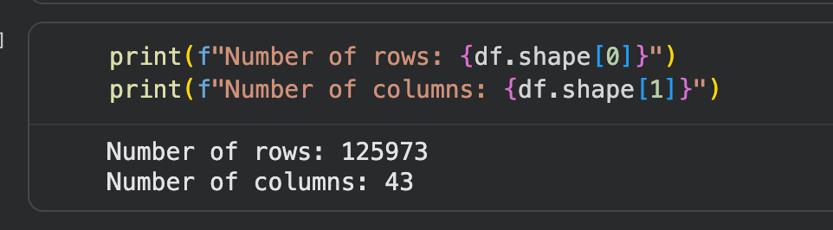
Data Overview
Data Statistics
Number of rows: 125973
Number of columns: 43
5

Slide 6
Data Overview
The Features
1.Basic Connection Features: These are the fundamental properties of any network traffic.
2. Content-Based Features These columns look inside the packets to find suspicious behavior like unauthorized login attempts or file access.
3. Time-Based Traffic Features These track how many connections happened within a 2-second window.
4. Destination Host Features These look at a larger window of time (the last 100 connections) to the same destination host to identify slow-scanning attacks.
5. Target Labels label: The "answer key." It tells you if the connection was normal or a specific type of attack (like neptune or satan).
6

Slide 7
Data Preprocessing
Data Cleaning
This dataset doesn’t have missing values.
Outlier values are key data here for network traffic classification.
Outlier values are key data here for network traffic classification.
Our exploratory statistics confirm that zero values dominate many features and should be preserved rather than imputed.
7

Slide 8
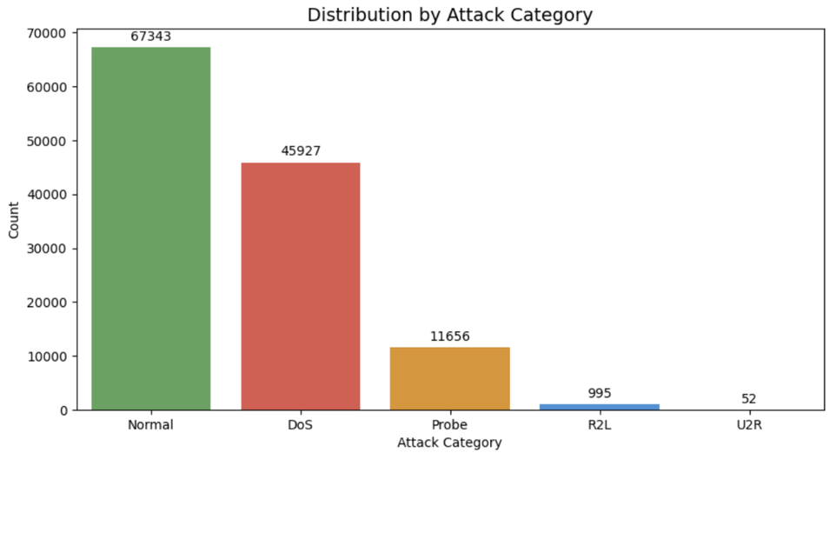
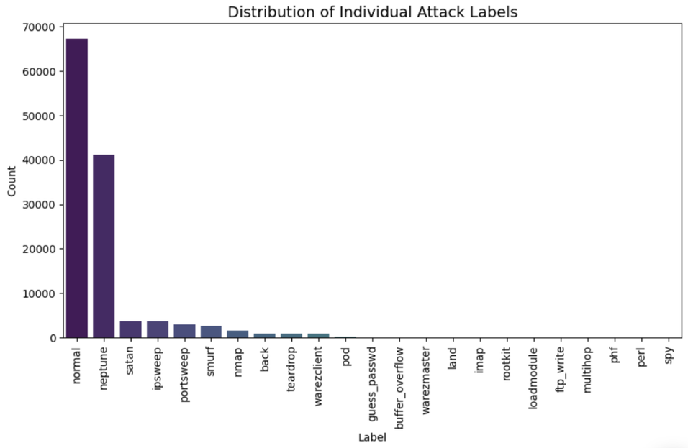
Exploratory Data Analysis
This chart shows a clear imbalance between normal and attack data.
The data shows a clear imbalance, so we will focus on binary classification first.
8

Slide 9
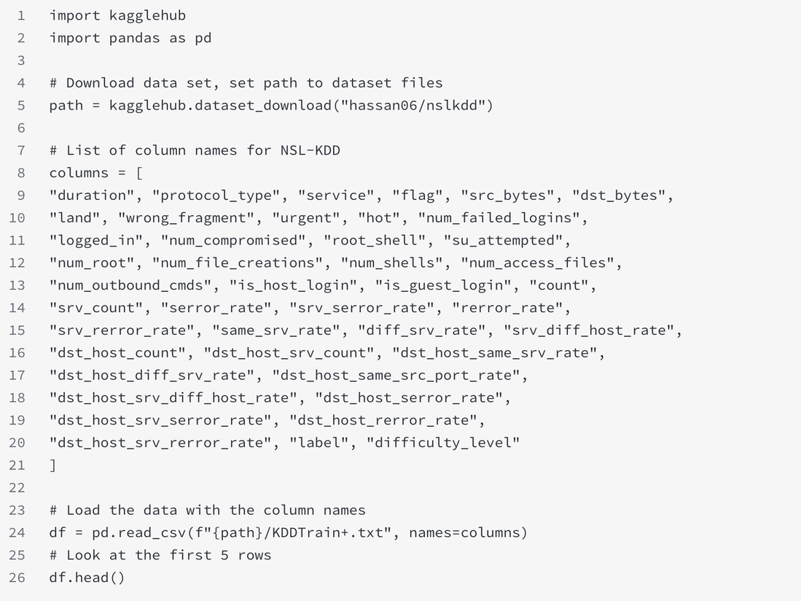
Implementation & Cod Overview
Load and Check Data
This code loads the NSL-KDD data and checks its basic structure.
It handles missing values and analyzes the distribution of key features.
This analysis provides a clear foundation for our machine learning model.
9

Slide 10
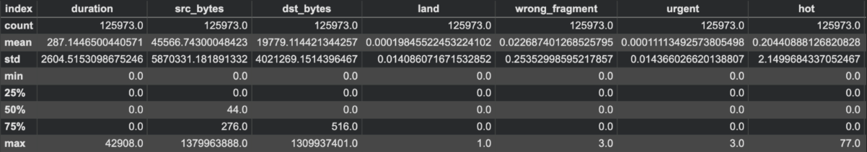
Implementation & Cod Overview
Statistical summary
This code performs data cleaning and exploratory analysis to build a solid foundation for our future machine learning model.
10

Slide 11
Findings & Modeling Direction
What did we find in the data?
What model will we use next?
Lots of Neptune attacks
DOS (Denial of Service) attacks were by far the most prevalent form of attack
U2R (User to Root) attacks were least prevalent
Categorization problem
Decision Tree model to categorize type of attack
11

Slide 12
EDA NSL-KDD Dataset
Group 2
Zahra Joulaei, Will Daly, Wei Dong
Thank You!
12

